Slide 1
軟體工程設計 W10
許庭瑋、陳君翰、洪世彬、劉玠均、楊昕叡、林俊佑
2023/11/23

Slide 2
Homework

Slide 3
HW0 - Can we add duplicate responsibilities in Decorator Pattern?
Yes we can, but sometimes it’s not good or useful doing that way.
In the FileViewer example
Duplicating thick border will make it have multiple border lines, which could be a feature.
However, duplicating scroll bar will make the display look weird.
In Coffee Shop example
Duplicating any condiment are fine and possible. For example, double mocha.
In Java I/O
duplicating FilterInputStream is not very helpful.

Slide 4
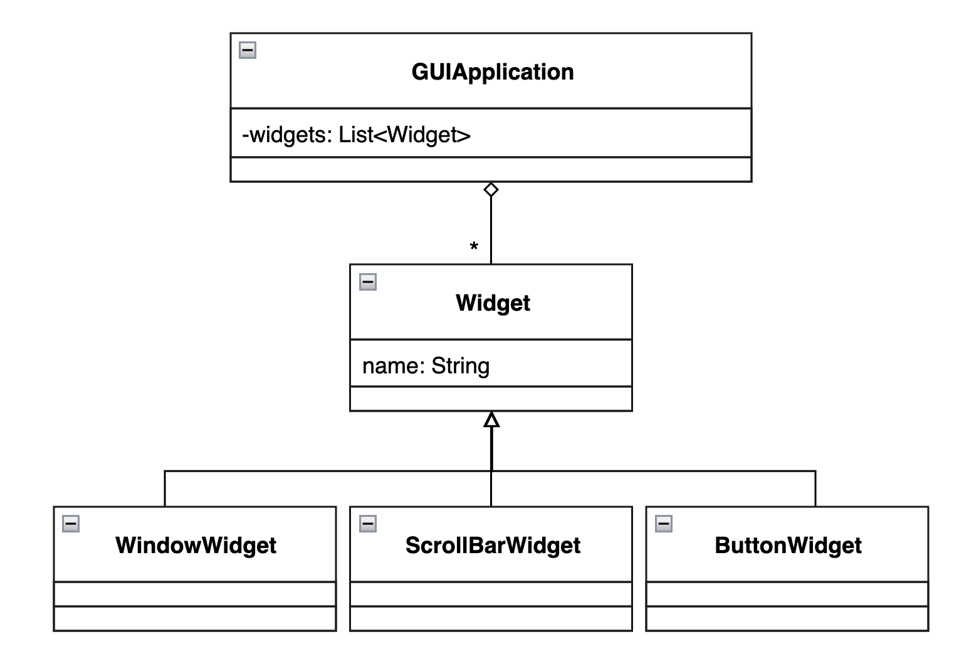
HW1 - GUI Application (Initial Design)
A GUI Application consists of various types of widgets such as windows, scroll bar, and button.

Slide 5
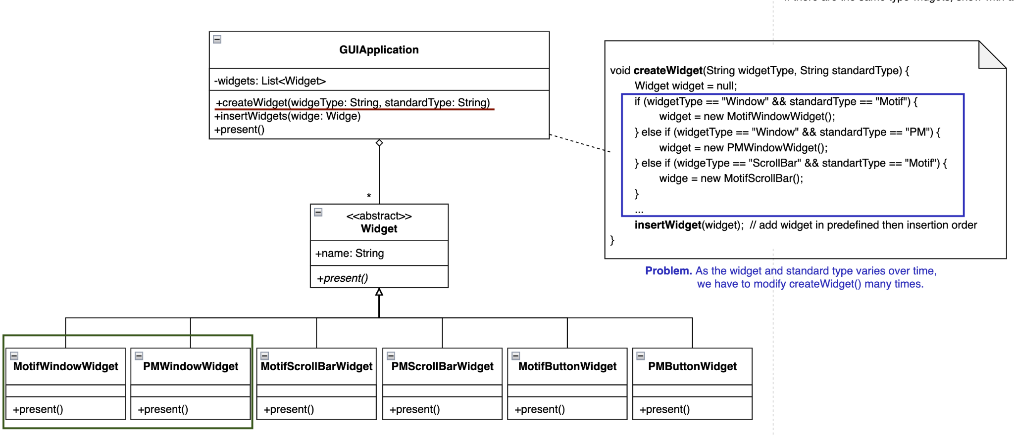
HW1 - GUI Application (Initial Design)
Each widget in the GUI application has two or more implementations according to different look-and-feel standards, such as Motif and Presentation Manager.

Slide 6
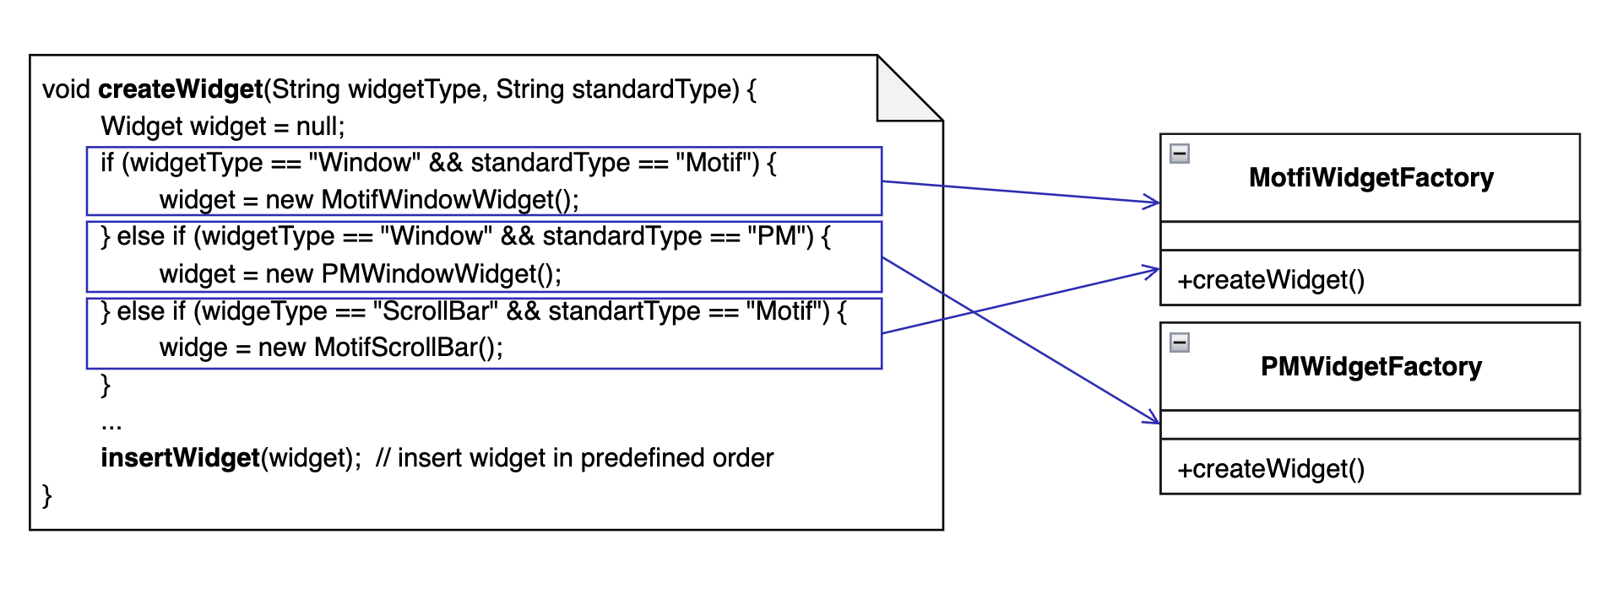
HW1 - GUI Application - Encapsulate What Varies

Slide 7
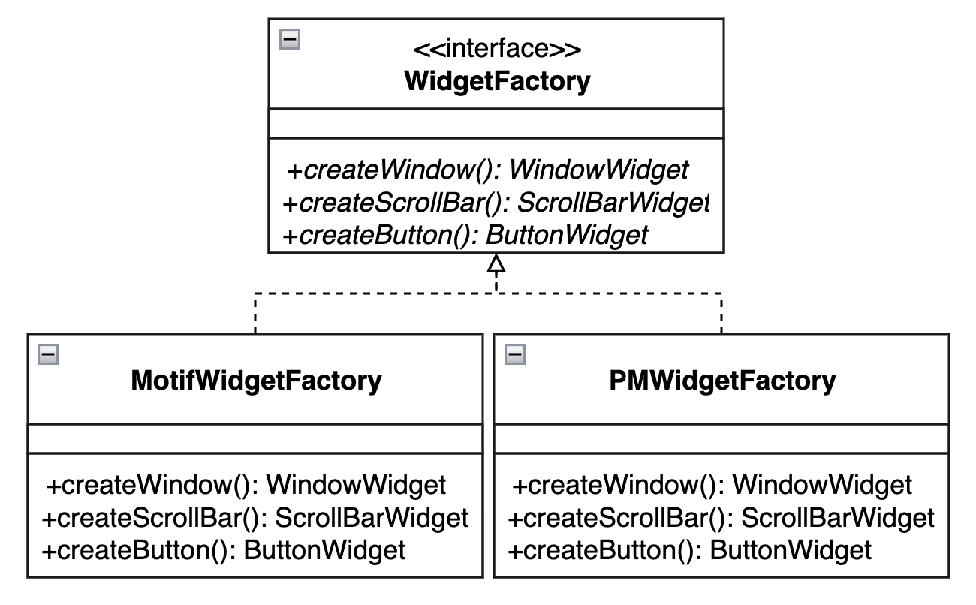
HW1 - GUI Application - Abstract Common Behavior
Produce PM widgets and Motif widgets by their corresponding factory.

Slide 8
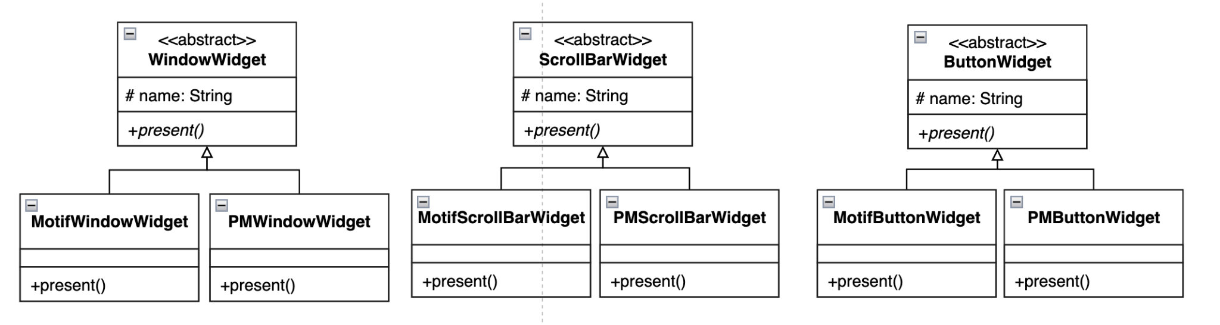
HW1 - GUI Application - Abstract Common Behavior
Abstract window widgets, scroll bar widgets, and button widgets. (break Widget into three classes)

Slide 9
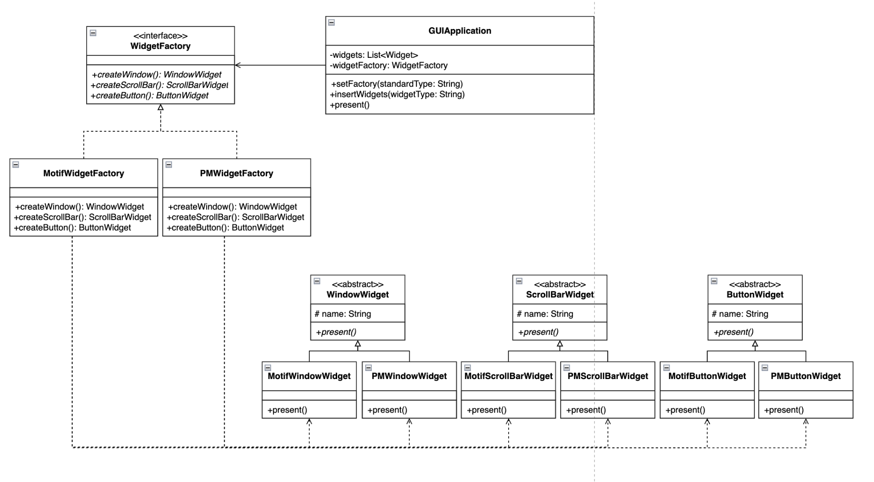
HW1 - GUI Application - Delegate Abstract Behavior

Slide 10
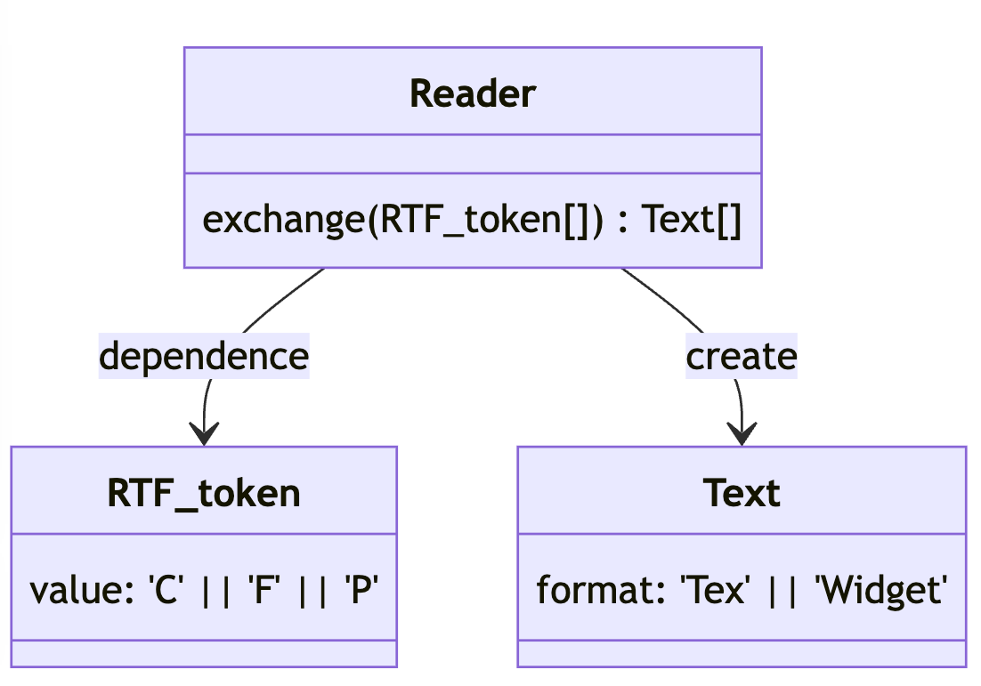
HW2 - RTF Converter
init design
A reader for the Rich Text Format (RTF) document exchange format should be able to convert RTF to many different text formats.
The reader converts RTF documents into TeX text or into a text widget by recognizing different RTF tokens (Character,Font Change and Paragraph).

Slide 11
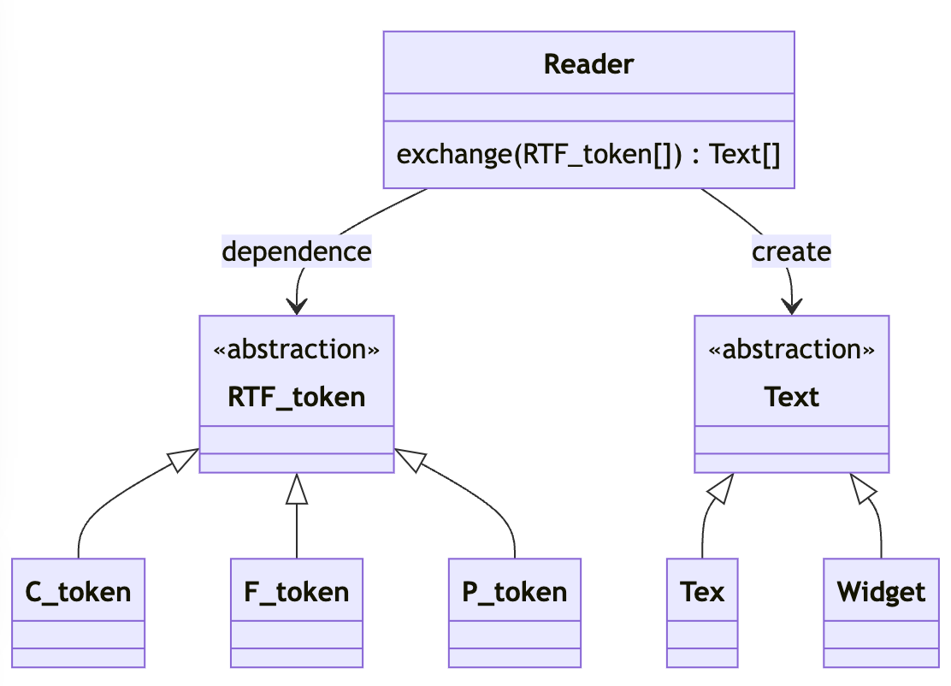
HW2 - RTF Converter
封裝變化
classDiagram
class RTF_token{
<<abstraction>>
}
class C_token{
}
class F_token{
}
class P_token{
}
RTF_token <|-- C_token
RTF_token <|-- F_token
RTF_token <|-- P_token
class Text {
<<abstraction>>
}
class Tex{
}
class Widget{
}
Text <|-- Tex
Text <|-- Widget
Reader --> RTF_token: dependence
Reader --> Text: create
class Reader{
exchange(RTF_token[]) Text[]
}

Slide 12
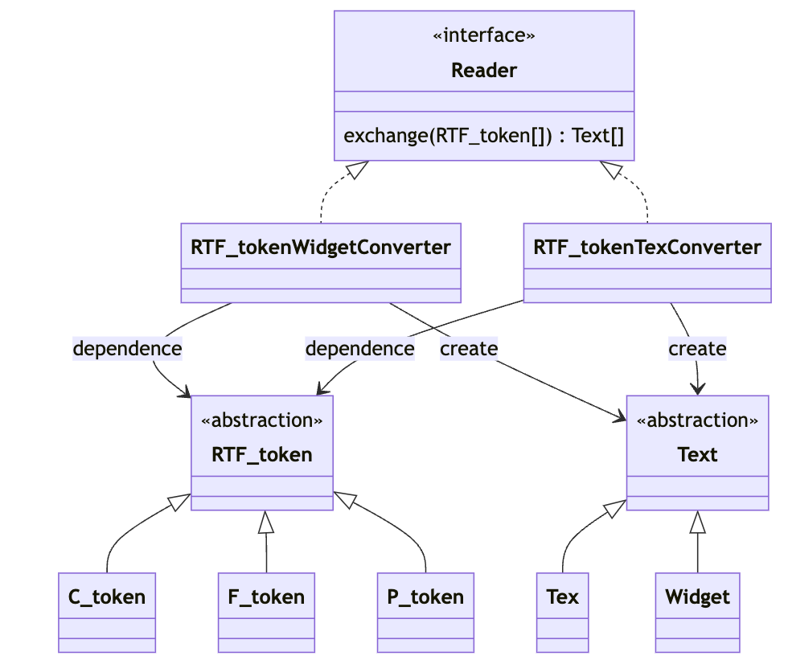
HW2 - RTF Converter
抽象物件與指派
classDiagram
class RTF_tokenTexConverter{
}
Reader <|.. RTF_tokenTexConverter
class RTF_tokenWidgetConverter{
}
Reader <|.. RTF_tokenWidgetConverter
class C_token{
}
class F_token{
}
class P_token{
}
class RTF_token{
<<abstraction>>
}
RTF_token <|-- C_token
RTF_token <|-- F_token
RTF_token <|-- P_token
class Text {
<<abstraction>>
}
class Tex{
}
class Widget{
}
Text <|-- Tex
Text <|-- Widget
RTF_tokenWidgetConverter --> RTF_token: dependence
RTF_tokenWidgetConverter --> Text: create
RTF_tokenTexConverter --> RTF_token: dependence
RTF_tokenTexConverter --> Text: create
class Reader{
<<interface>>
exchange(RTF_token[]) Text[]
}

Slide 13
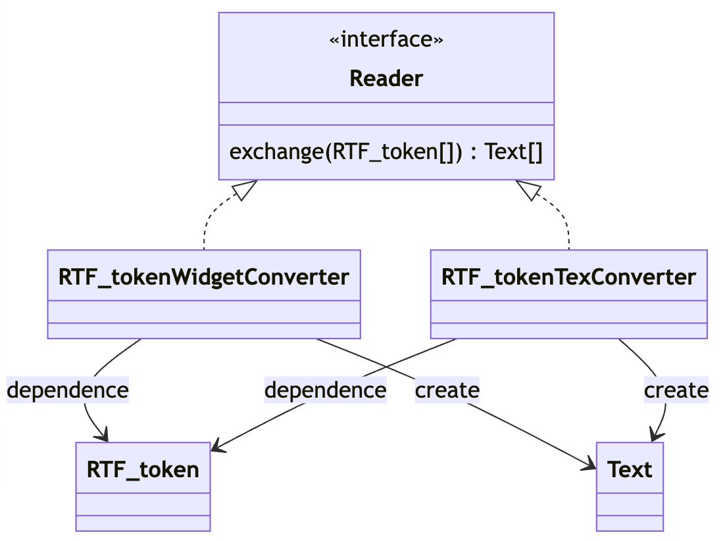
HW2 - RTF Converter
重構
把轉換邏輯移入 converter, 簡化 token 抽象
classDiagram
class RTF_tokenTexConverter{
}
Reader <|.. RTF_tokenTexConverter
class RTF_tokenWidgetConverter{
}
Reader <|.. RTF_tokenWidgetConverter
class C_token{
}
class F_token{
}
class P_token{
}
class RTF_token{
<<abstraction>>
}
RTF_token <|-- C_token
RTF_token <|-- F_token
RTF_token <|-- P_token
class Text {
<<abstraction>>
}
class Tex{
}
class Widget{
}
Text <|-- Tex
Text <|-- Widget
RTF_tokenWidgetConverter --> RTF_token: dependence
RTF_tokenWidgetConverter --> Text: create
RTF_tokenTexConverter --> RTF_token: dependence
RTF_tokenTexConverter --> Text: create
class Reader{
<<interface>>
exchange(RTF_token[]) Text[]
}

Slide 14
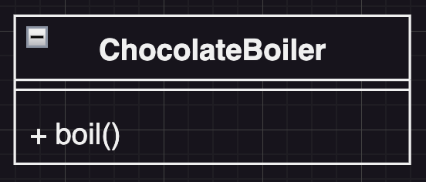
HW3 - Chocolate Boiler
A chocolate boiler is used to boil chocolate.

Slide 15
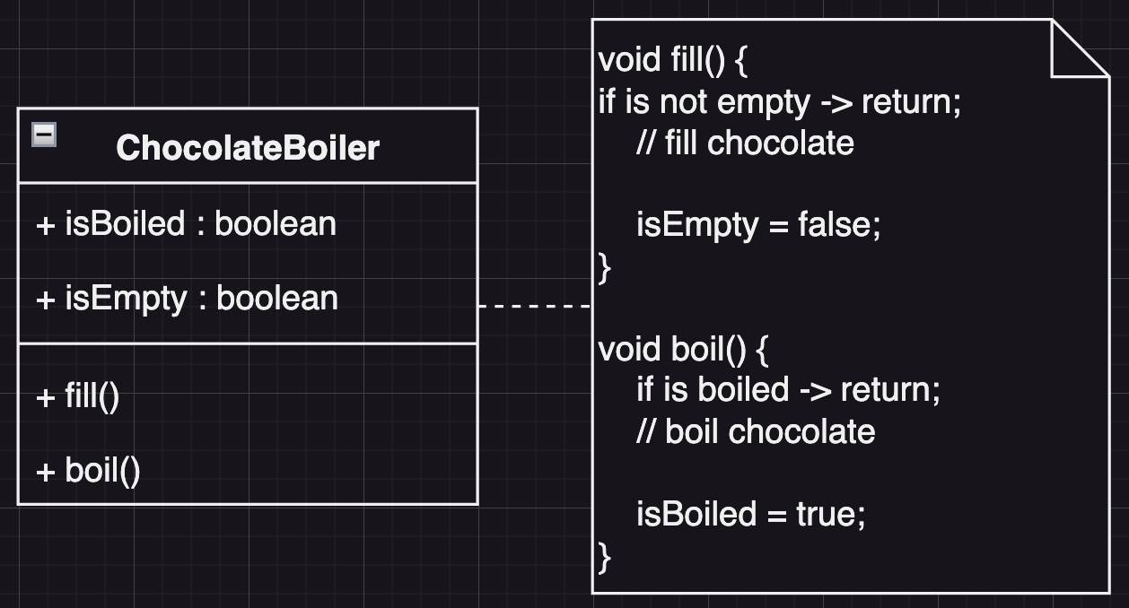
HW3 - Chocolate Boiler
Before boiling chocolate with the boiler, you have to make sure that the boiler is now empty and then fill chocolate in. Besides, you can’t boil chocolate again while the chocolate has already been boiled.

Slide 16
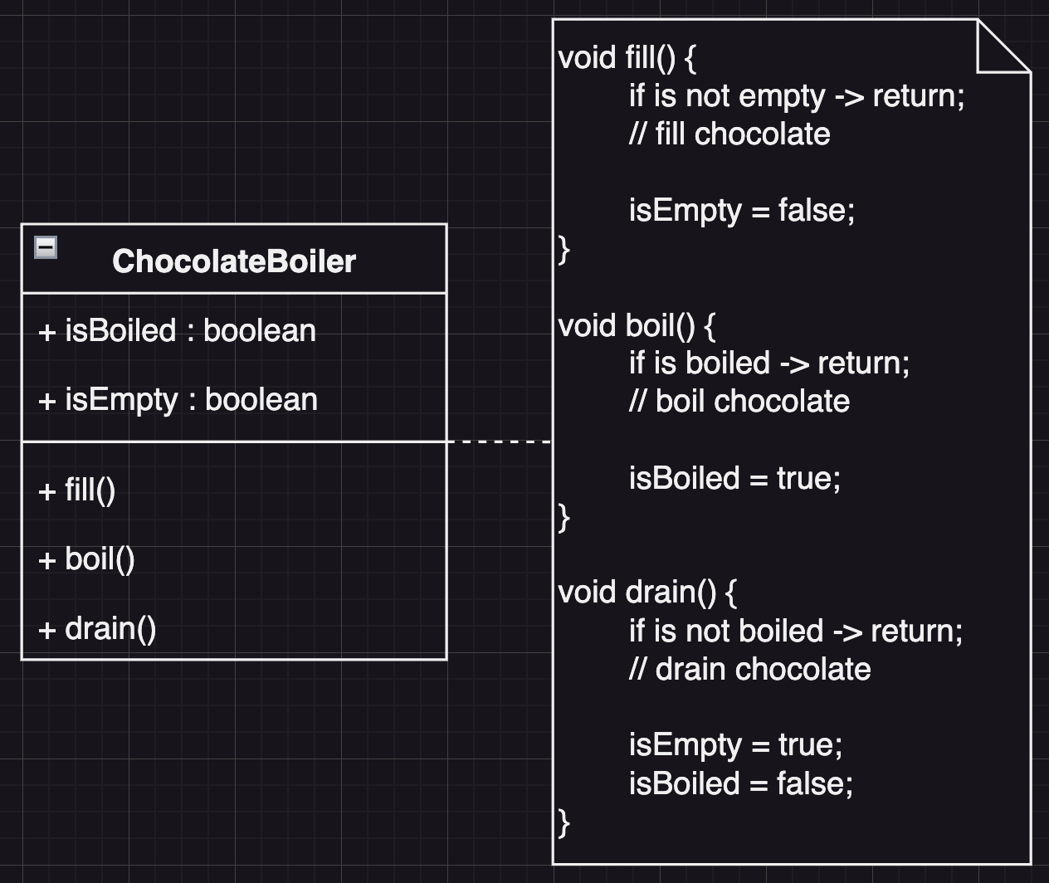
HW3 - Chocolate Boiler
After boiling, drain out the boiled chocolate and make the boiler empty again.

Slide 17
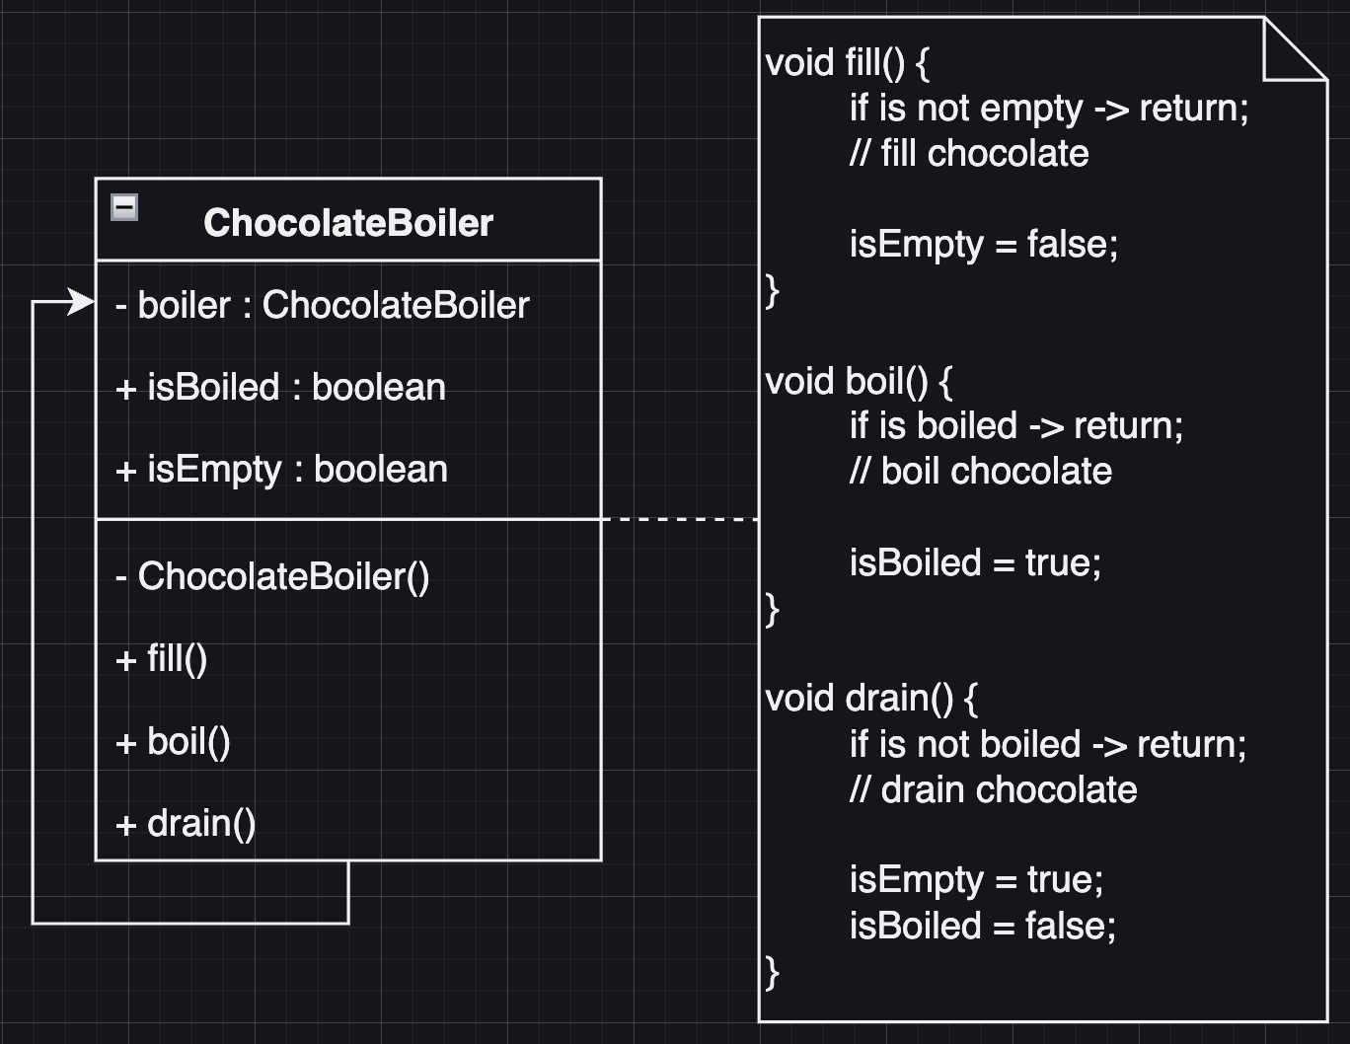
HW3 - Chocolate Boiler
In order to prevent some unexpected situation, it is not allowed to have multiple instances of the chocolate boiler in the system.

Slide 18
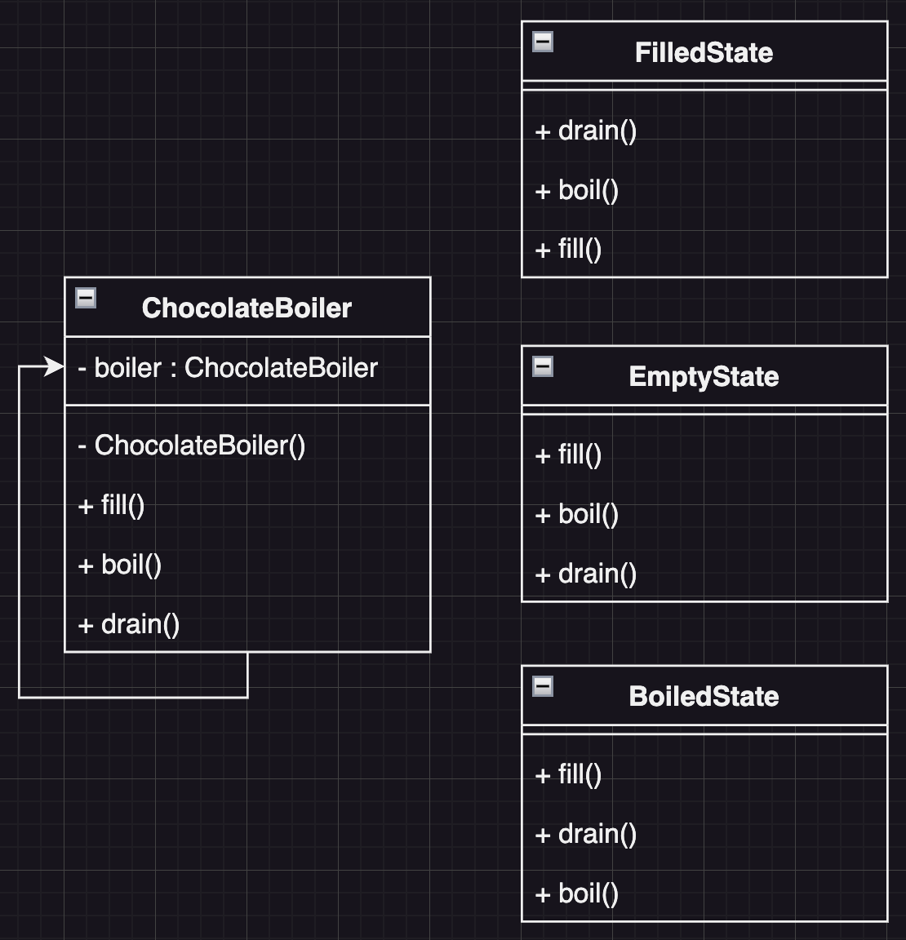
HW3 - Chocolate Boiler
Encapsulation
Encapsulate the boolean flags to different state

Slide 19
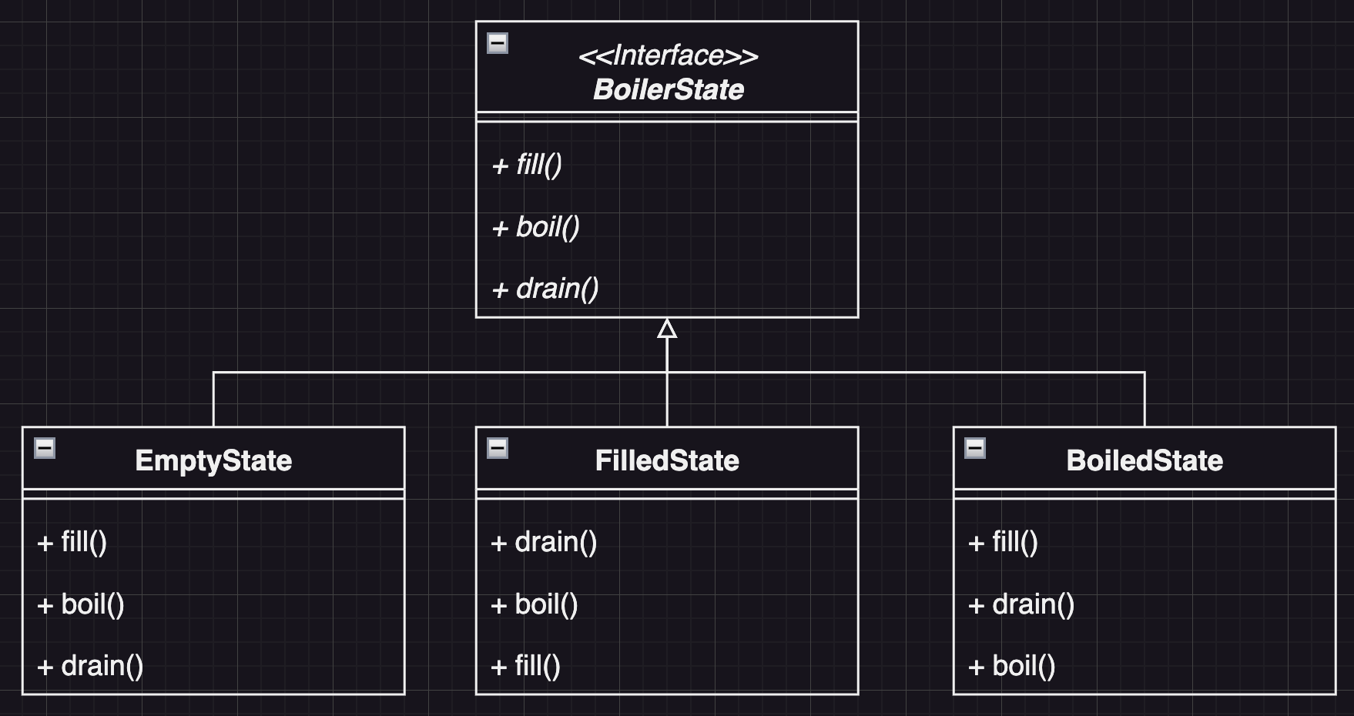
HW3 - Chocolate Boiler
Abstraction
Create a BoilerState Interface

Slide 20
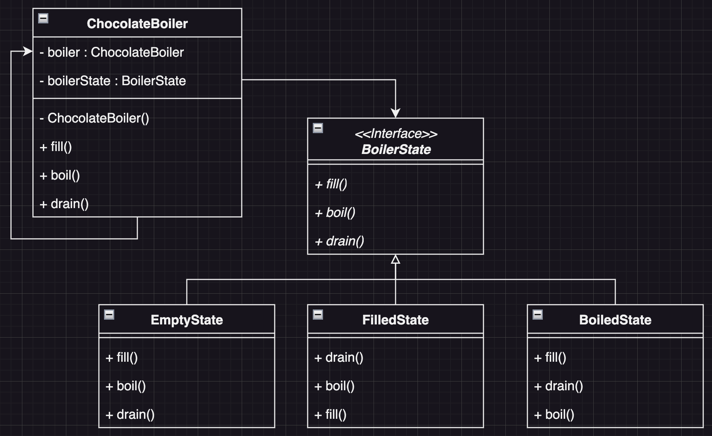
HW3 - Chocolate Boiler
Delegation
Delegate actions of ChocolateBoiler to BoilerState

Slide 21
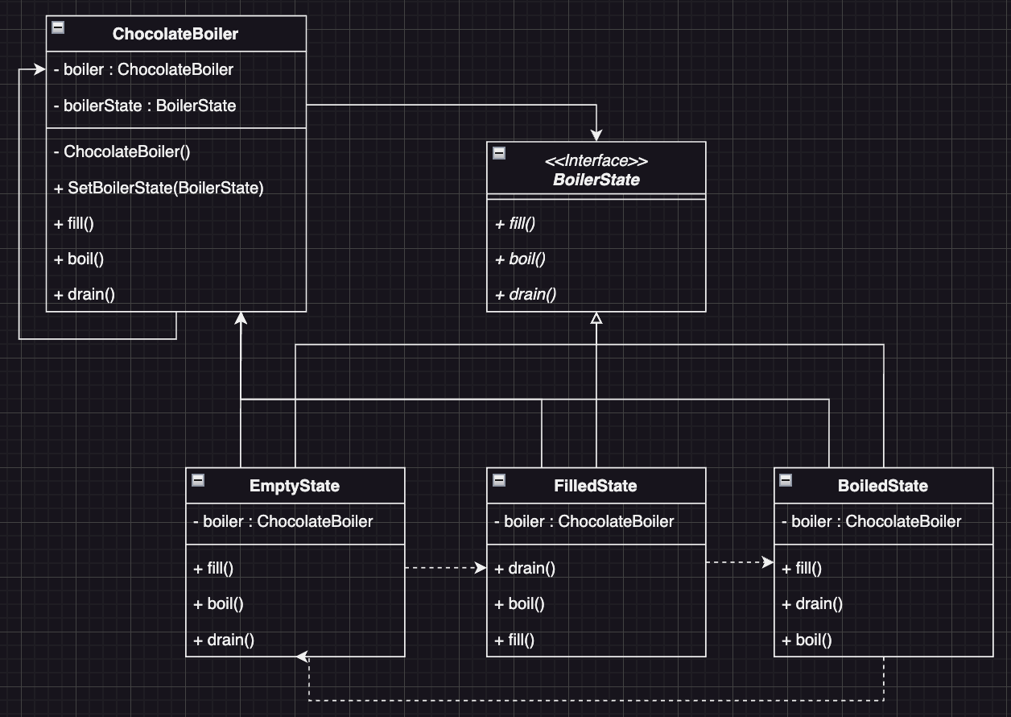
HW3 - Chocolate Boiler
Add SetBoilerState for state change

Slide 22
Code Tracing

Slide 23
Weekly Code Tracing Progress
 | Part | LOC
spring-core-core
許庭瑋 | DataBufferUtils.java | 703
楊昕叡 | AnnotatedElementUtils.java, AnnotationAttributes.java, AnnotationAwareOrderComparator.java | 477
劉玠均 | type/filter/*.java, type/*Metadata.java (except Annotat*Metadata.java) | 514
洪世彬 | ReactiveAdapterRegistry.java, SerializableTypeWrapper.java | 495
spring-core-aot, spring-core-cglib
陳君翰 |  | 673
林俊佑 | cglib.core.CodeEmitter | 611

Slide 24
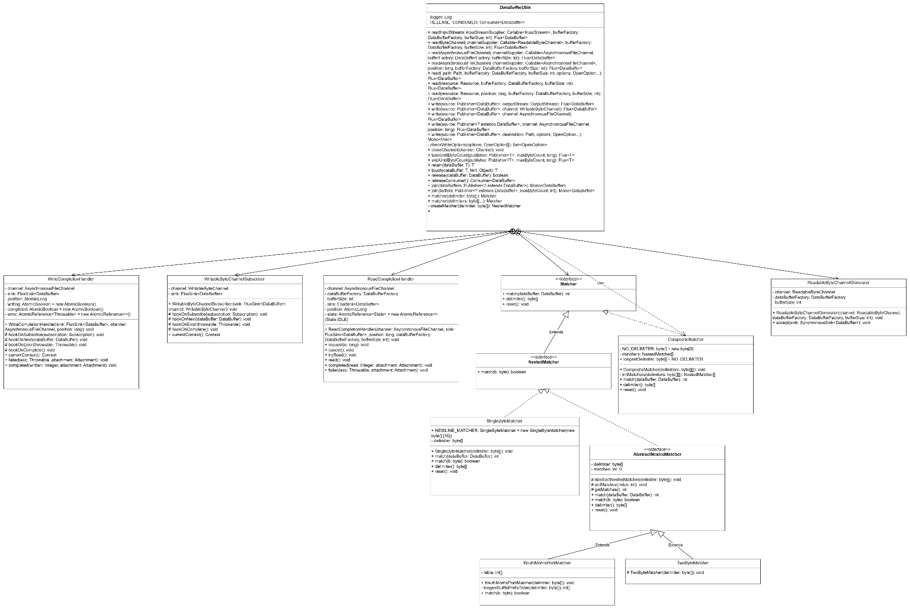
許庭瑋
UML for this week
only one file: DataBufferUtils
others are inner classes
full version

Slide 25
許庭瑋
DataBufferUtils
Utility class for working with DataBuffer
readByteChannel:read a ReadableByteChannel into a Flux DataBuffers
readAsynchronousFileChannel:
read from path: open path, and use readAsynchronousFileChannel
read from Resource: if Resource is a file, use readAsynchronousFileChannel, or use readByteChannel
write: Write the given stream of DataBuffers to the given WritableByteChannel/OutputStream/AsynchronousFileChannel/Path…
takeUntilByteCount: read buffer from Publisher until readableByteCount() reachs given maxByteCount
skipUntilByteCount: slip buffer from Publisher until readableByteCount() reachs given maxByteCount

Slide 26
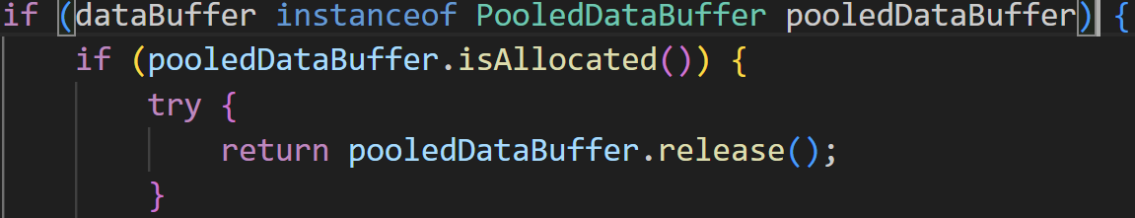
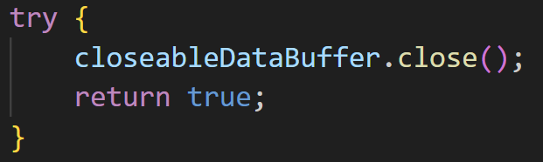
許庭瑋
DataBufferUtils
retain: retain given PooledDataBuffer
touch: touch given TouchableDataBuffer
release: the most important function in DataBufferUtils. Because in core.io, only DataBufferUtils::release is called in other class. release buffers, if buffers are PooledDataBuffer, use release(). if buffers are CloseableDataBuffer, use close()
join: return a DataBuffer composed
of joining together the given dataBuffers

Slide 27
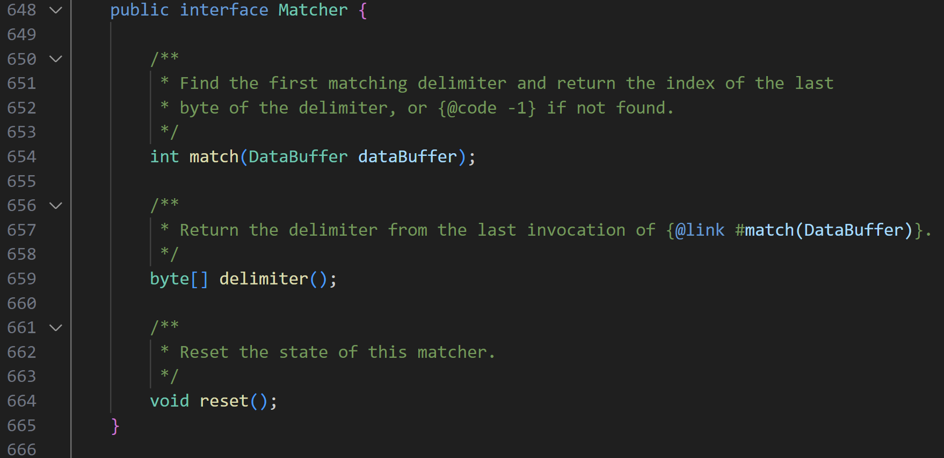
許庭瑋
DataBufferUtils
very interesting thing: an inner interface in a class!

Slide 28
許庭瑋
DataBufferUtils
there are many inner class in DataBufferUtils, some of them are implement or extend from Matcher to support different types of delimiter
CompositeMatcher: implements Matcher, supports searching for multiple delimiters
SingleByteMatcher: Matcher for a single byte delimiter
AbstractNestedMatcher: implements NestedMatcher (NestedMatcher extends Matcher)
many interface injection, like this one, DataBuffer is an interface, and there are many different types of DataBuffer which I have read in the last few weeks.

Slide 29
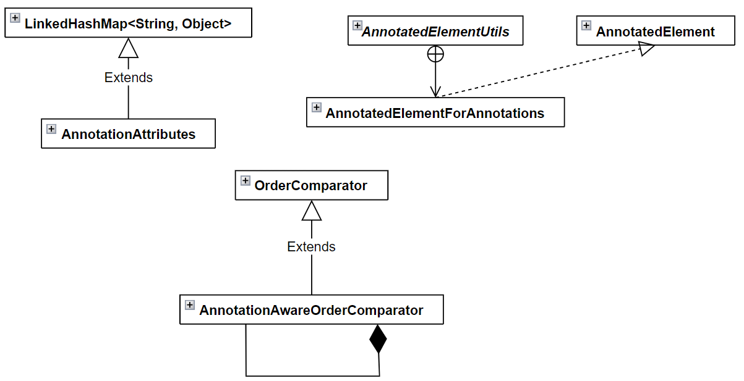
楊昕叡
class diagram:
full version

Slide 30
楊昕叡
public abstract class AnnotatedElementUtils
This class provide methods for finding annotations, meta-annotations, and repeatable annotations AnnotatedElements:
getMergedAnnotationAttributes(), getMergedAnnotation(), getAllMergedAnnotations(), getMergedRepeatableAnnotations(), findMergedAnnotationAttributes(), findMergedAnnotation(), findAllMergedAnnotations(), and findMergedRepeatableAnnotations()

Slide 31
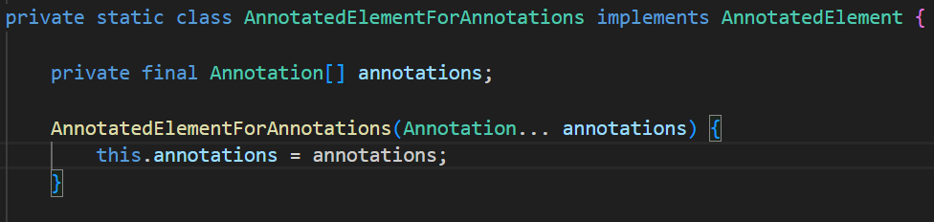
楊昕叡
public abstract class AnnotatedElementUtils
Dependency injection is used in its inner class, which contains the annotations of interest.

Slide 32
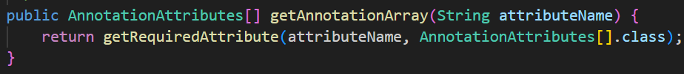
楊昕叡
public class AnnotationAttributes extends LinkedHashMap<String, Object>
This class acts as a map, but in fact it consists of many methods returning common Object types and they call the same method: getRequiredAttribute().
It avoid creating a map for every Object type.

Slide 33
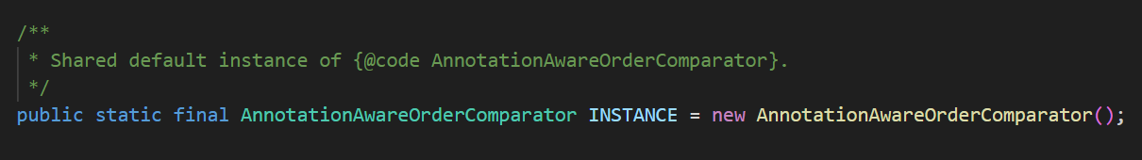
楊昕叡
public class AnnotationAwareOrderComparator extends OrderComparator
“Order” is used to prioritize objects.
This class provide methods for getting order and sorting objects by order.
This class has no constructor and use a shared instance, Singleton pattern is used here. The reason may be that these methods are applicable to all annotation thus sharing an instance is enough and more efficient.

Slide 34
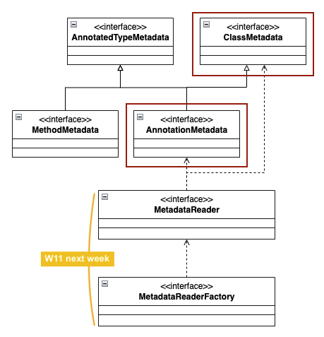
劉玠均 (type/*Metadata.java)
Class diagram full version
Define interfaces:
- ClassMetadata
- MethodMetadata
- AnnotationMetadata
for MetadataReaderFactory to read metadata by MetadataReader.
This is a factory pattern. It defines abstract metadata of a class, method, or annotation without loading their concrete class.

Slide 35
劉玠均 (type/*Metadata.java)
Concrete classes that implements abstract metadata (i.e., MethodMetadata and AnnotationMetadata) are defined in classreading folder (next week).
Hence, in runtime, client can access corresponding concrete metadata via reader factory without knowing the exact concrete classes.

Slide 36
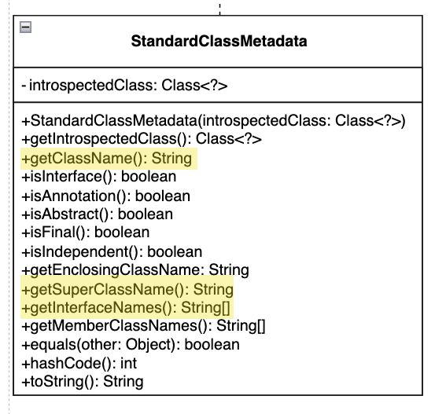
劉玠均 (type/StandardClassMetadata.java)
Metadata encapsulates java.lang.Class functions. Getting their metadata by .getName(). The mapping is as follow:
StandardClassMetadata | java.lang.Class
getClassName() | getName()
getEnclosingClassName() | getEnclosingClass().getName()
getSuperClassName() | getSuperclass().getName()
getInterfaceNames() | getInterfaces(), for each getName()
getMemberClassNames() | getDeclaredClasses(), for each getName()
isInterface() | isInterface()
isAnnotation() | isAnnotation()

Slide 37
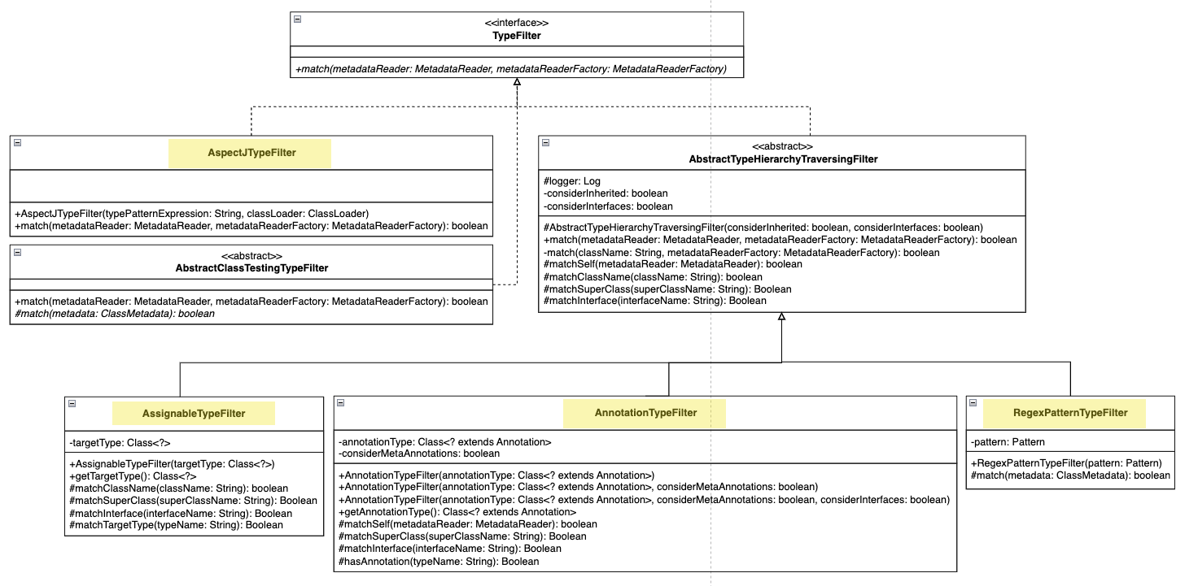
劉玠均 (filter/*.java)
Type filters for Annotation, AssignableType, AspectJ, Regex.

Slide 38
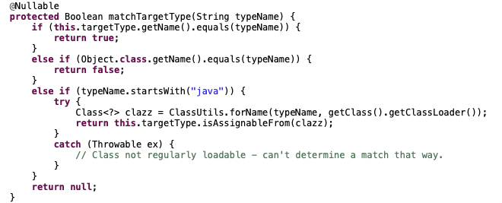
劉玠均 (filter/*.java)
Take AssignableTypeFilter for example, it’s match*() functions use matchTargetType() to determine if the target type is assignable from or equals to the given type name.

Slide 39
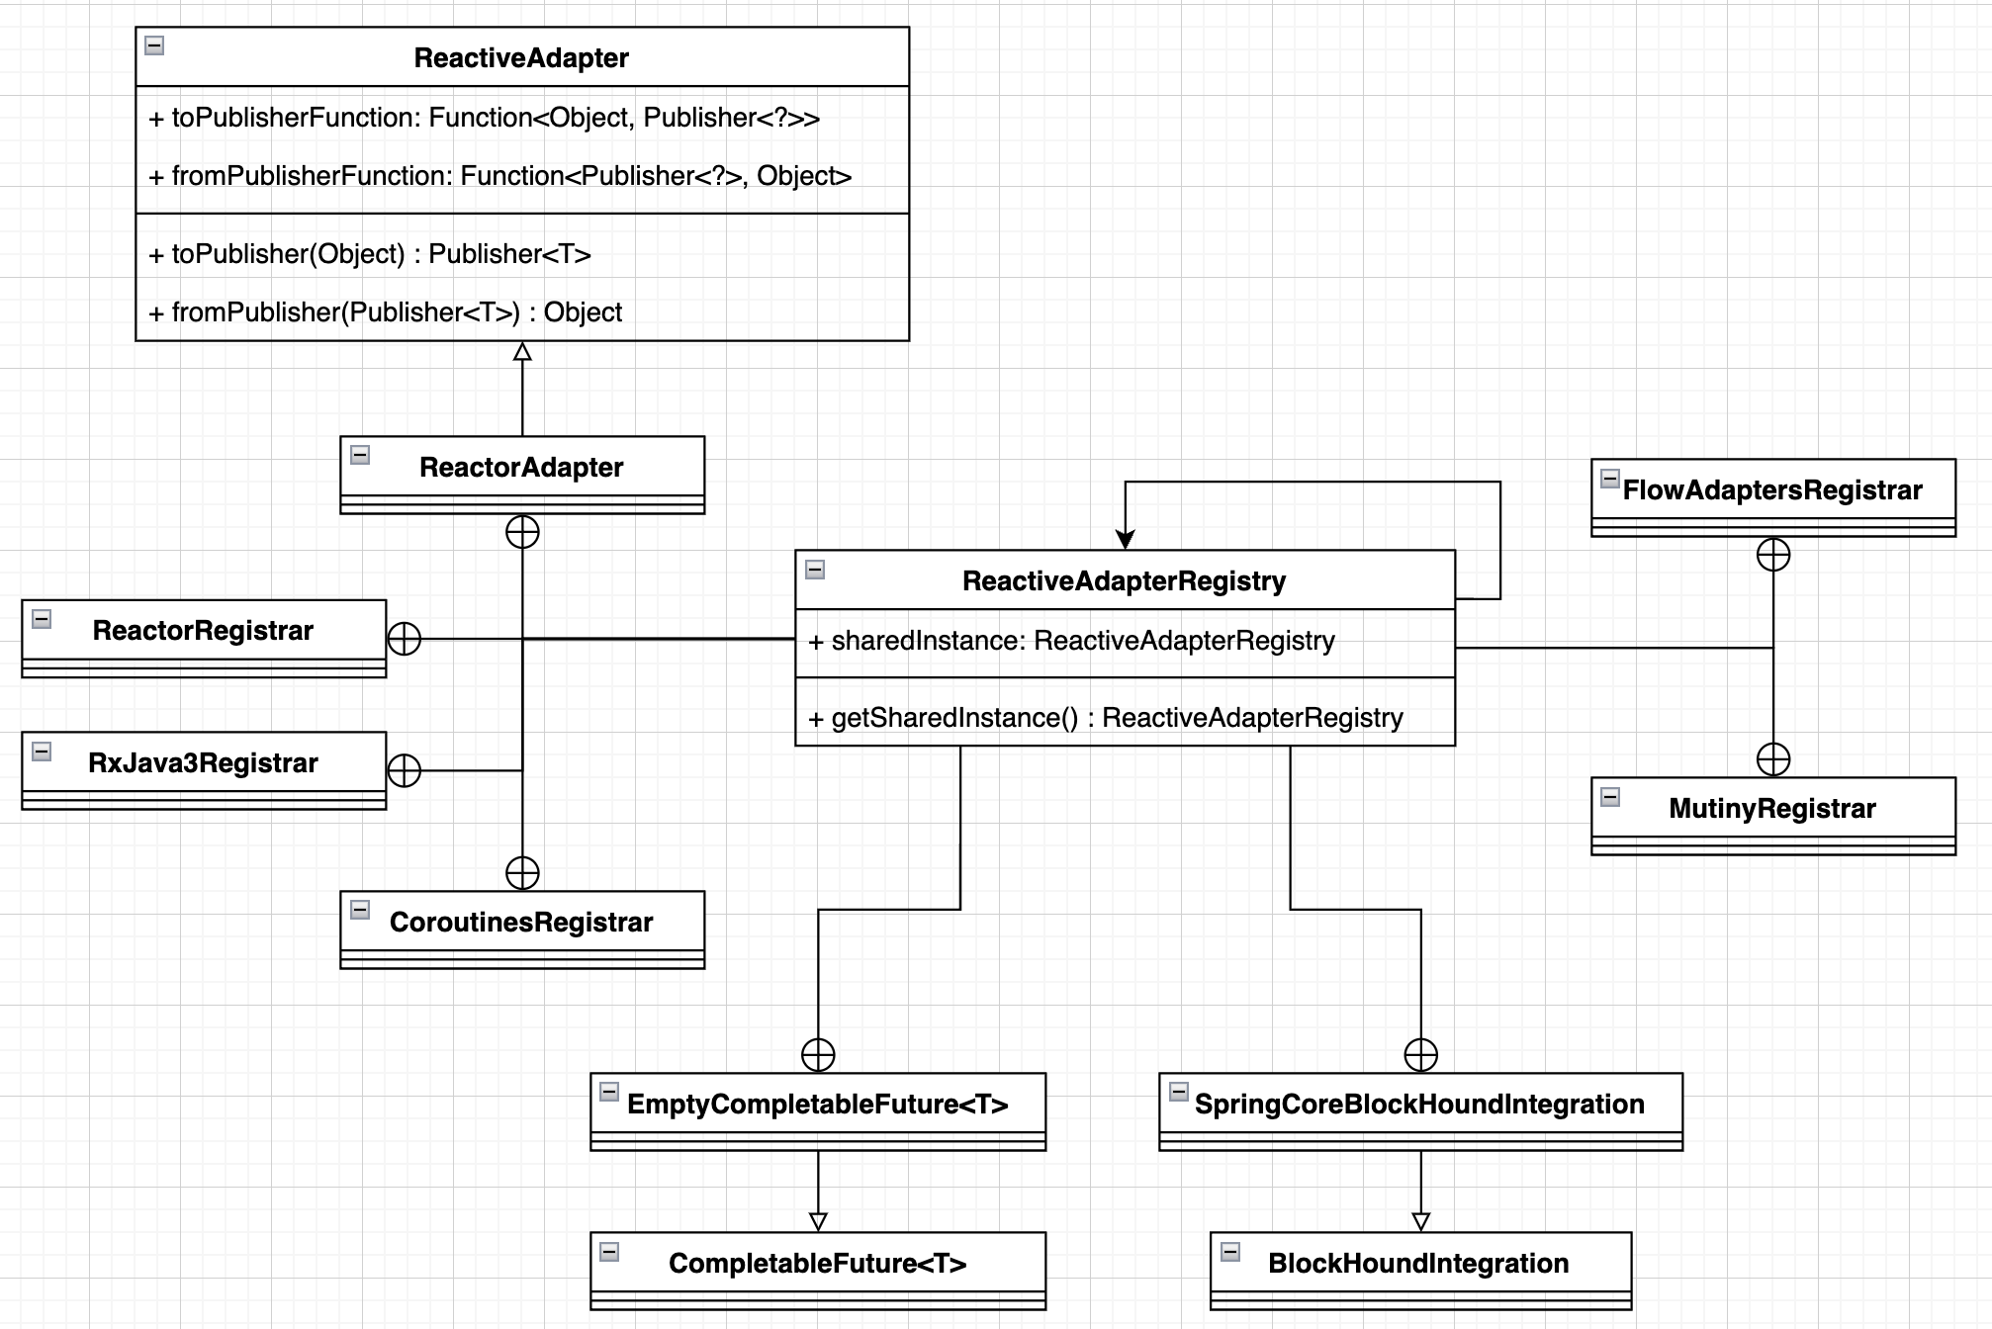
洪世彬
This time, I am looking at two files, SerializableTypeWrapper and ReactiveAdapterRegistry.
On the right side is the UML diagram for ReactiveAdapterRegistry.

Slide 40
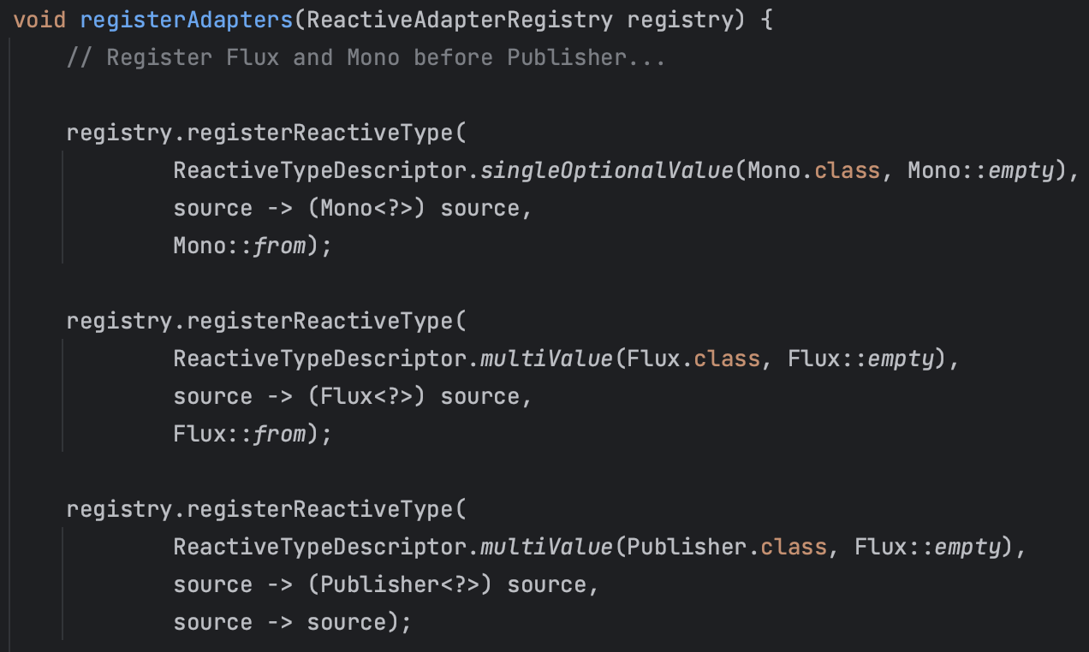
洪世彬
ReactiveAdapterRegistry is mainly responsible for creating a global Adapter repository, allowing all developers in need of type conversion to find and use pre-written Adapters.
The diagram on the right shows some of the Adapters that are pre-registered.

Slide 41
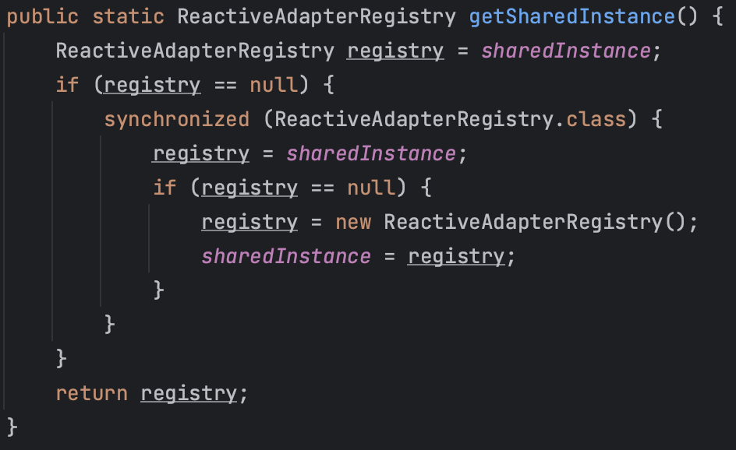
洪世彬
Since ReactiveAdapterRegistry aims to create a global Adapter repository and avoids having multiple instances within the program, it adopts the Singleton Pattern.
The right side shows its implementation.

Slide 42
洪世彬
Although it has "Adapter" in its name, it doesn't actually use the Adapter Pattern. The Adapter here is essentially used only for the purpose of type conversion.

Slide 43
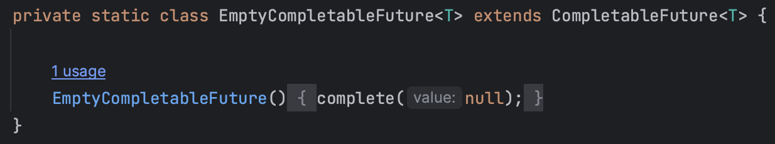
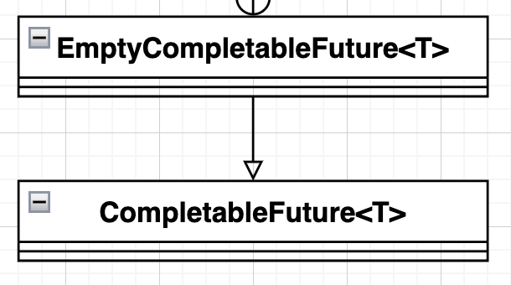
洪世彬
In the case of EmptyCompletableFuture, the Null Object Pattern is employed.

Slide 44
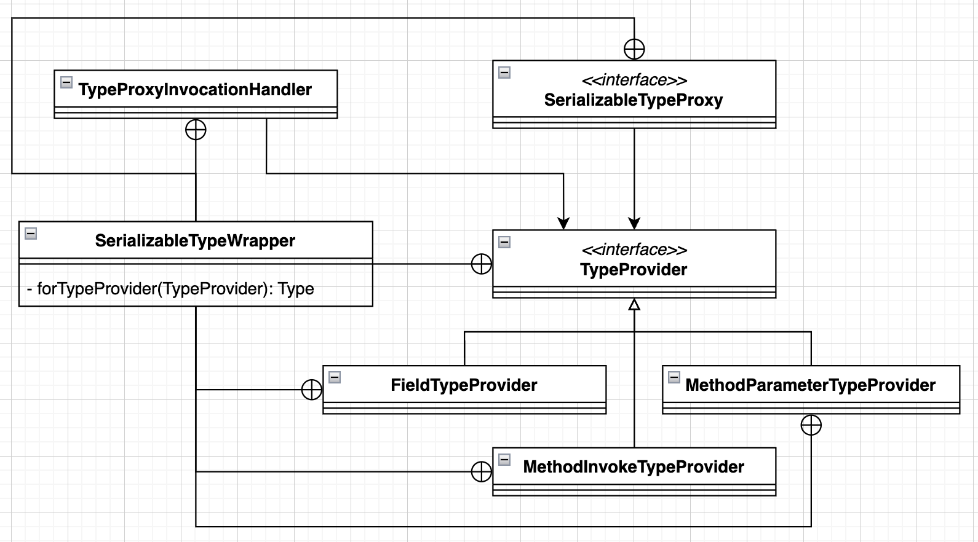
洪世彬
Next is the SerializableTypeWrapper, and on the right is its UML diagram. Similar to ReactiveAdapterRegistry, it also creates many inner classes to divide responsibilities.

Slide 45
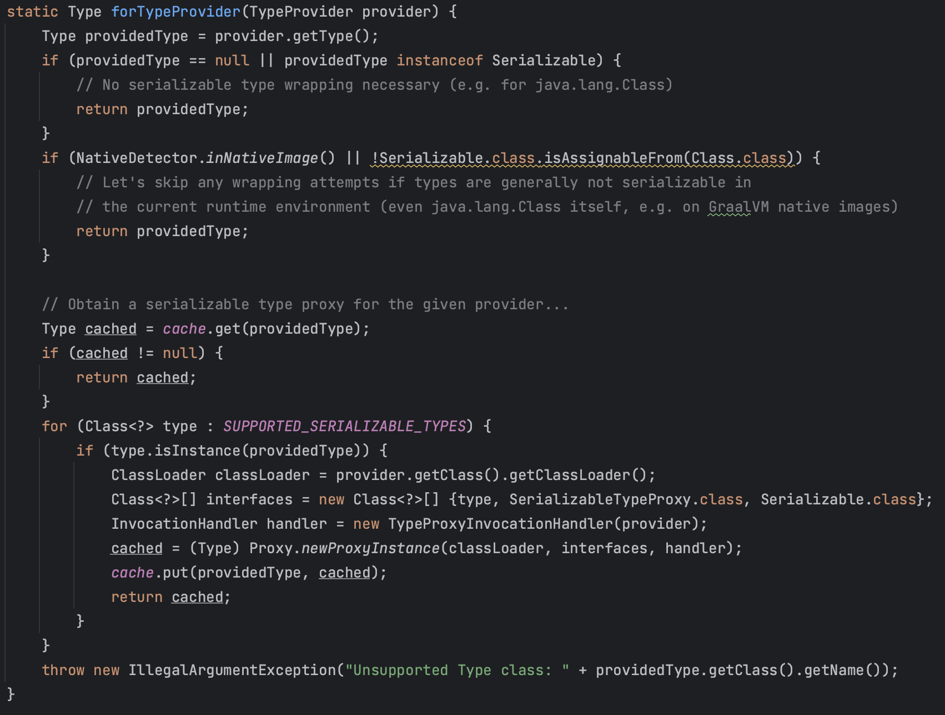
洪世彬
SerializableTypeWrapper is primarily for internal framework use. Users pass in an object, and it can return a Type that can be serialized or its Proxy.

Slide 46
洪世彬
The FieldTypeProvider, MethodParameterTypeProvider, and MethodInvokeTypeProvider correspond to three different contents within an object.

Slide 47
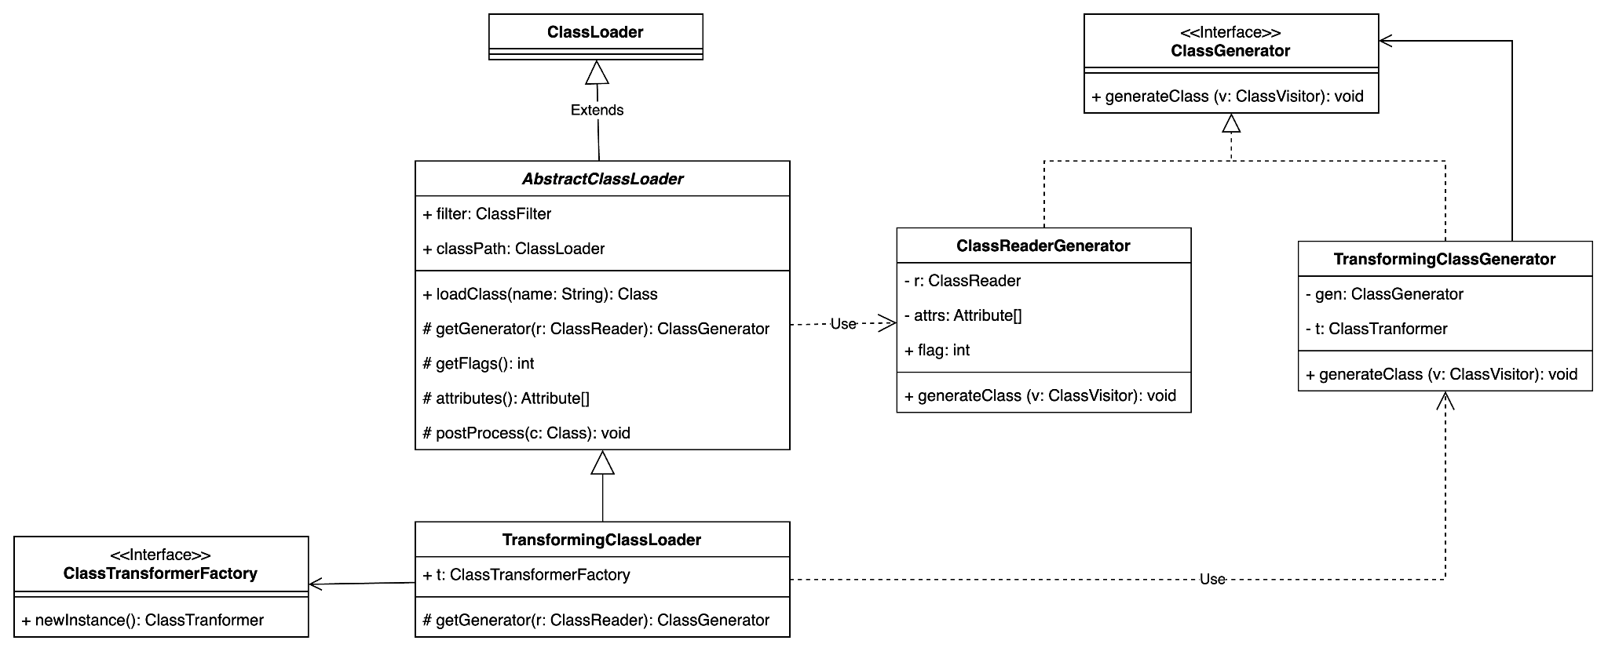
陳君翰
基本上就是個 Factory Pattern
Loader 是 Creator，Generator 是 Product

Slide 48
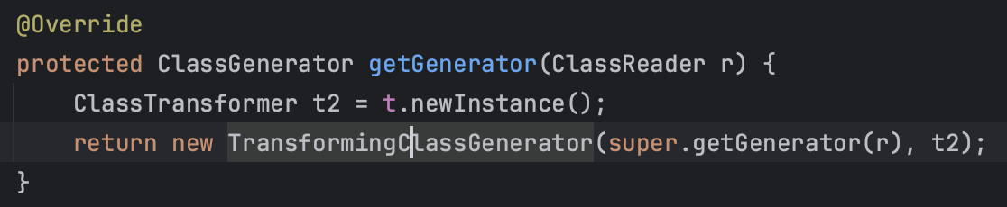
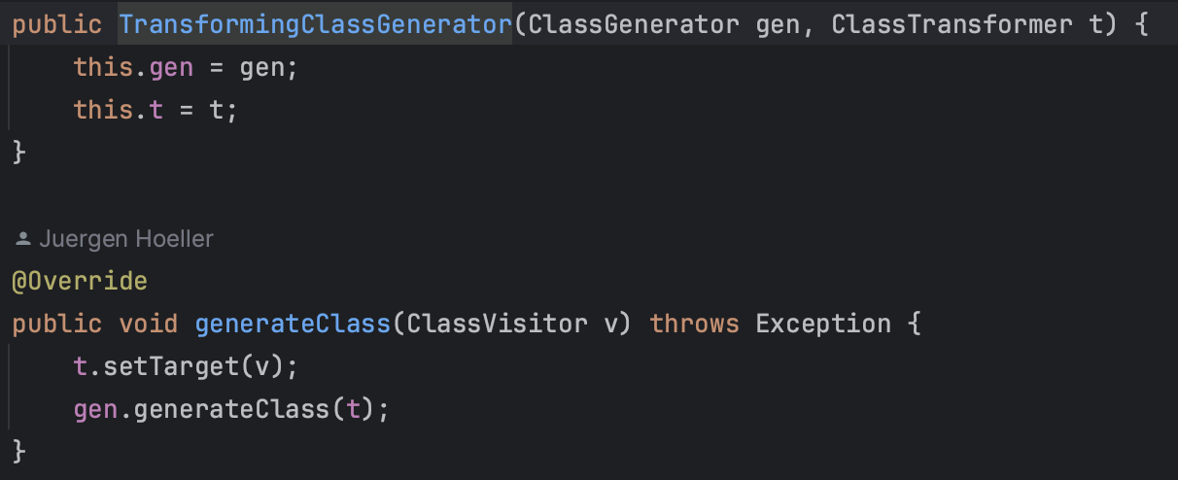
陳君翰
ClassLoader.getGenerator() 會回傳一個新的 ClassGenerator

Slide 49
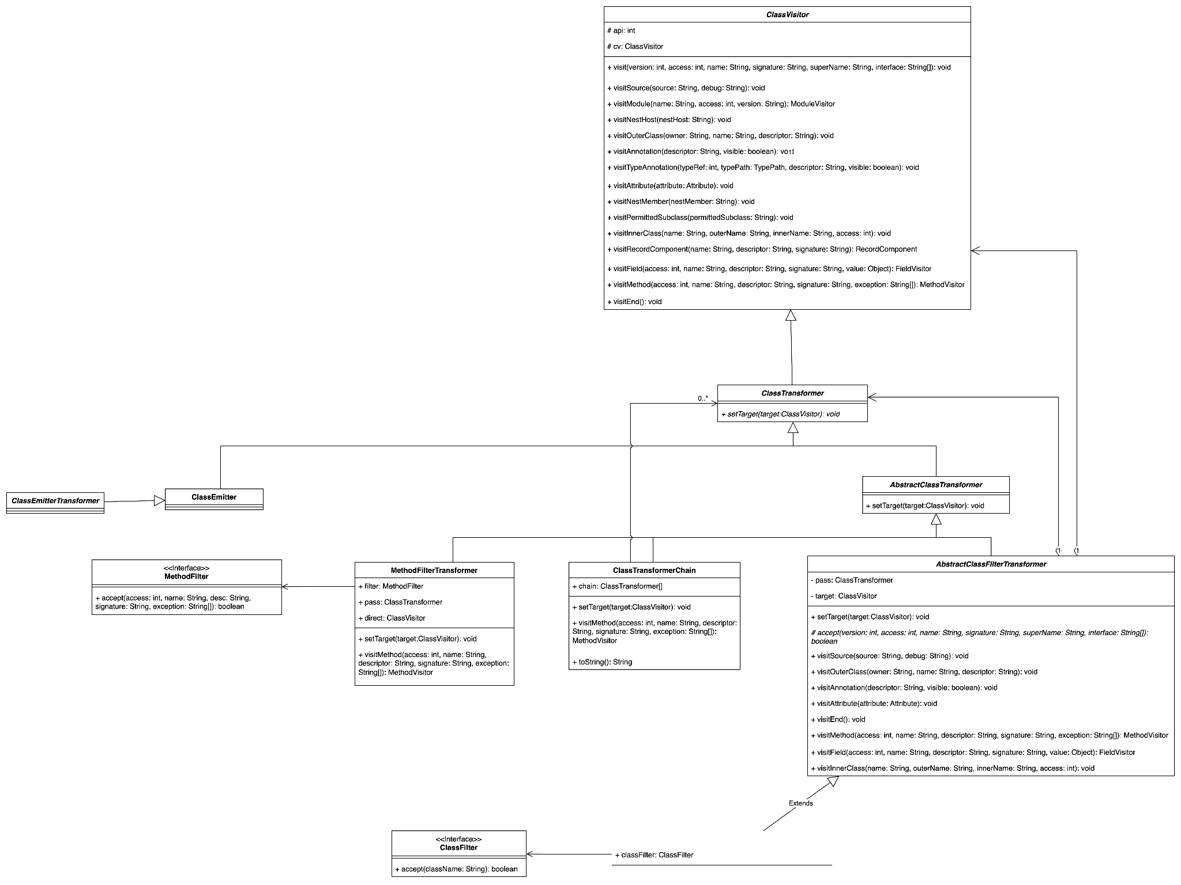
陳君翰
一路繼承下來，但不同繼承的主要差異只是其中的 classVisitor，導致實際做事的 object 不同
有一點 Decorator 的味道，但應該是其他 pattern

Slide 50
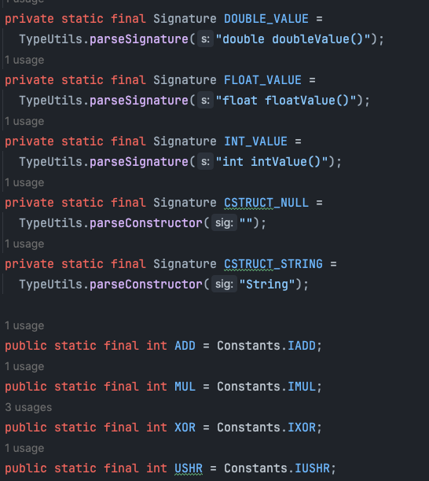
林俊佑
今天開始看調用 ASM API 的核心邏輯 CodeEmitter
Signature 可以拿來把 asm 取到 JVM 中變數的型別轉換成 java class 中的型別
ex:
BOOLEAN_VALUE
CHAR_VALUE
LONG_VALUE
Constants.操作 用 int 表示, 是 JVM 要用的操作符號代號
ex:
EQ = Constants.IFEQ = 153 = if equal
NE = Constants.IFNE = 154 = if not equal
另外組合 ClassEmitter 和 State 其中 State 用來存下當前狀態

Slide 51
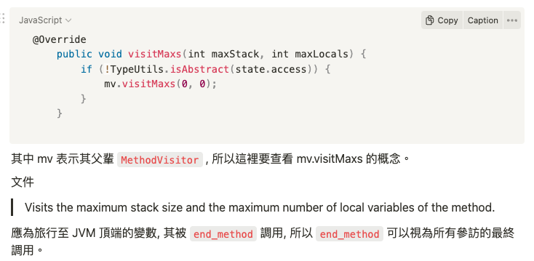
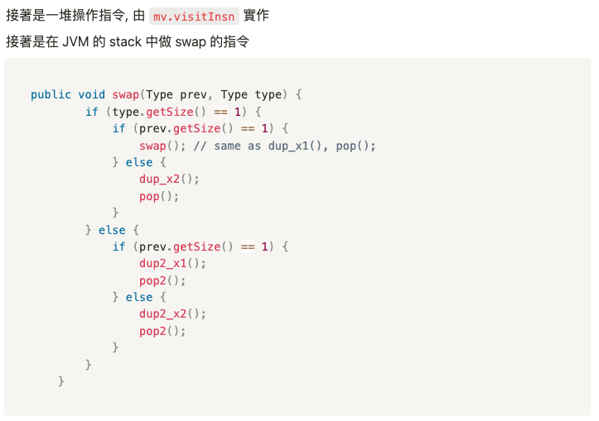
林俊佑
接著大多數的函數都是對 JVM mapping 的 stack 操作
完整記錄參考我的筆記：https://leon1234858.notion.site/backup-8471887c73944e76a739261e0abf6ee6

Slide 52
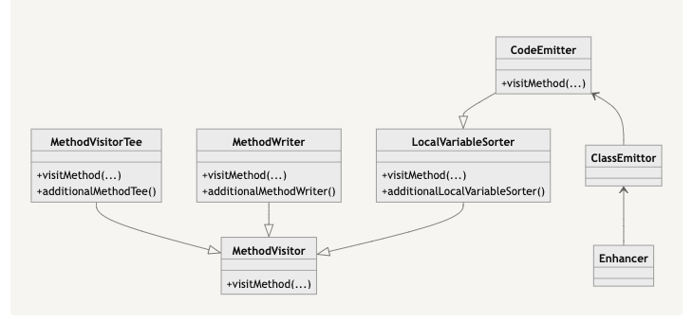
林俊佑
其中雖然只有 MethodVisitor 是 asm package 但 CodeEmitter 大量相依於 asm 的物件且 MethodWriter 又是 asm package, 整個調用流程很混亂,在各個 package 跑來跑去, 於是我開始思考, 這是否是某種 design pattern, 基於這個概念傳達的資訊足以讓讀者了結其概念
最終, 我發現這類似 observer 模式, client 端 class Emittor 透過調用 CodeEmitter 讀寫其內部狀態存儲的 JVM stack Mapping, 不需要回傳。
MethodWriter 則在需要生成方法時被調用, CodeEmitter 被當 MethodWriter 把 stack mapping 到 method 傳出

